Slide 1










VIDEO GAMES SALES DATA PIPELINE
Mostafa Mohamed Ismail

Slide 2


PROBLEM STATEMENT
Raw data contains issues:
"N/A" values instead of numbers
Missing values
Different data formats
Business needs:
Clean data
Automated pipeline
Easy visualization for insights

Slide 3
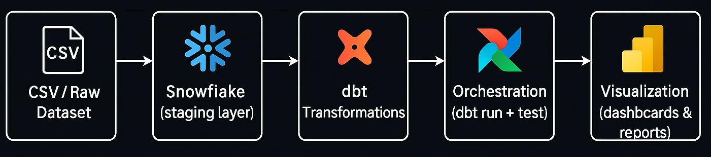


DATA PIPELINE ARCHITECTURE

Slide 4





🧹 DATA CLEANING
01
Removed incomplete rows
Dropped records with missing values in critical fields (Name, Platform, Year, Genre, Publisher, Sales).
Enforced correct data types
Converted Rank and Year into integers.
Converted Sales values into floats for accurate calculations.
Handled missing values
Replaced any remaining null sales values with 0.0 using COALESCE.
Standardized column names
Renamed raw columns into meaningful business terms (e.g., na_sales → North America Sales (M) ).
02
03
04

Slide 5
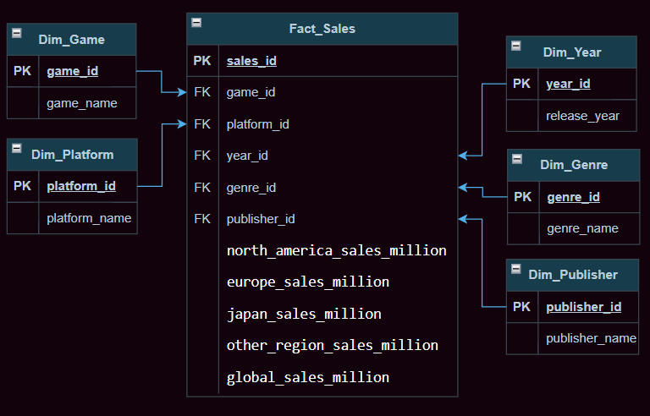

DATA MODELING
⭐ WHY STAR SCHEMA?
01
Simplicity
Easy to understand: one Fact table (sales) linked to multiple Dimension tables (games, publishers, platforms, time).
02
Query Performance
Optimized for analytical queries in Snowflake & Power BI (fewer joins, faster aggregations).
03
Flexibility in Analysis
Allows slicing and dicing data by Year, Platform, Genre, Publisher, etc.
04
Best Practice in Data Warehousing
Star schema is the industry standard for BI tools like Power BI, Tableau.

Slide 6
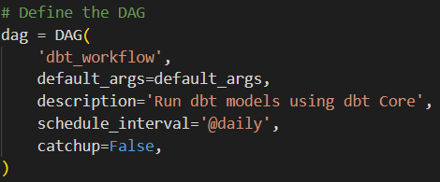
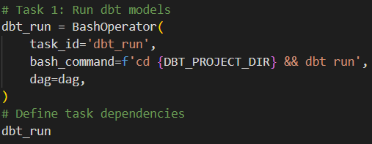
AUTOMATION
01
DAG Definition
Name: dbt_workflow
Runs daily (@daily).
02
Task: Run dbt Models
Executes dbt run command inside the project directory.
Builds and refreshes data models in Snowflake.

Slide 7
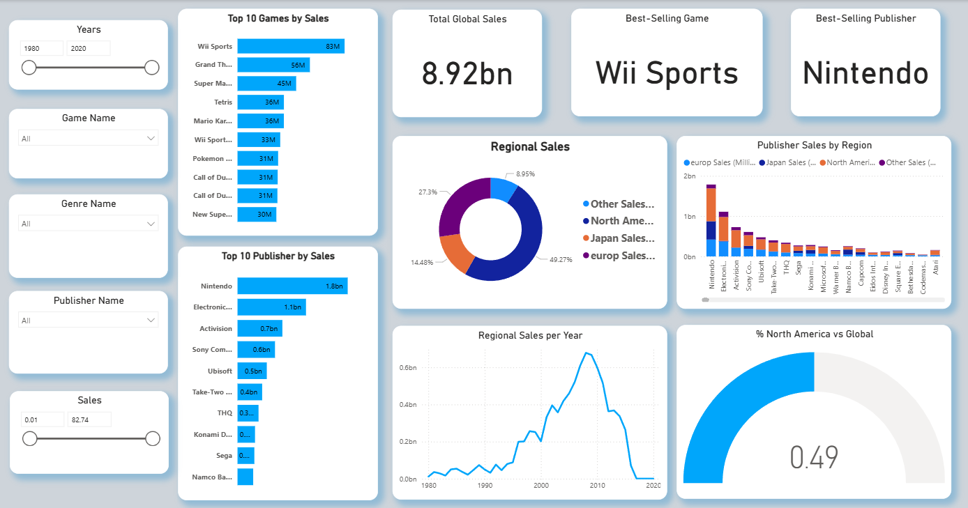

DASHBOARD (POWER BI)

Slide 8
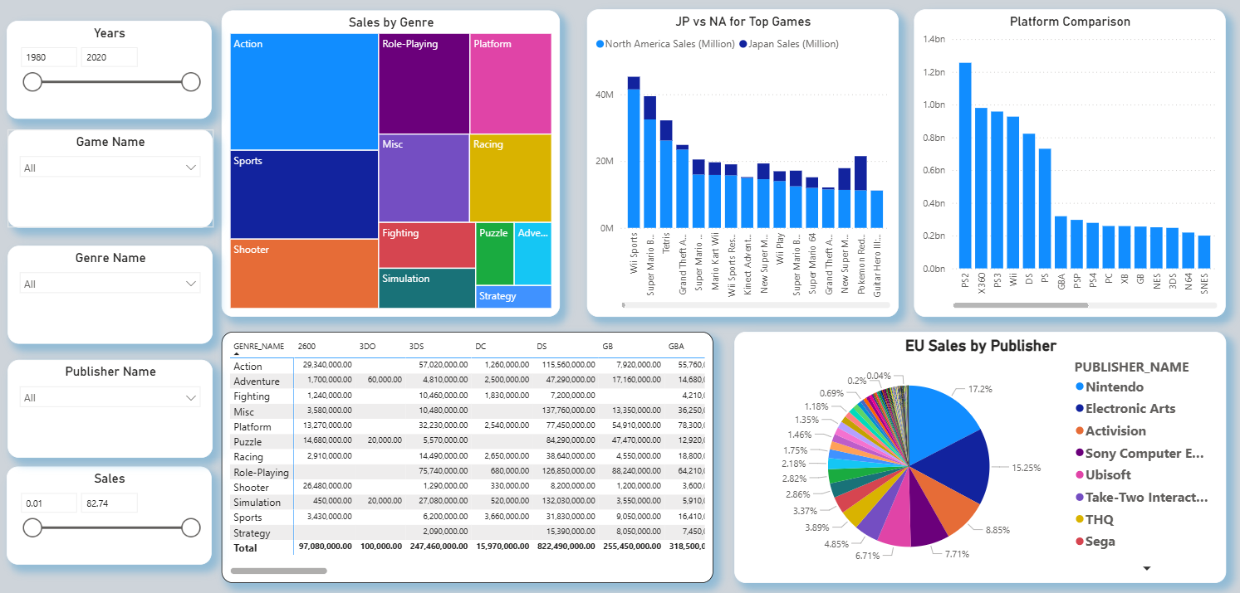
DASHBOARD (POWER BI)

Slide 9

CHALLENGES & SOLUTIONS
01
Data quality issues → Solved by cleaning (null removal, type casting, handling N/A).
02
Large raw data → Automated with Airflow + dbt.
03
Business understanding → Visualized in Power BI.
CONCLUSION
01
Built an end-to-end data pipeline: raw → cleaned → Snowflake → Power BI.
02
Automated pipeline with Airflow.
03
Designed Star Schema for analytics.

Slide 10
THANK
YOU

